Slide 1
Resources and Levelling
420-E31 Systems III
References:
Chapter 3
Uyttewaal,Eric. Dynamic scheduling with Microsoft Office Project. J. Ross Publishing, 2005.

Slide 2
Right Level of Detail for Tasks
Too Little?
Can I estimate the duration, effort and cost?
Can I identify the dependencies?
Can task be assigned to an individual?
Too Much?
Real task or to-do item?
Is task necessary?
Do I want to update all these tasks?
Notes:
1% - 10% Rule
Duration of any detail task should be between 1% and 10% of project duration

Slide 3
Why is Right Level Important?
Create enough checkpoints for monitoring and controlling the progress of the project
Don’t want multiple reporting periods with tasks not completed
Don’t want too many tasks completed in one period or plan will not be read by client
Need to know for risk management

Slide 4
Difficulties and Techniques
What unit of time do I use?
What do I include?
Unknowns
Unknown events
Unknown resources
Unknown experience/skill level
Unknown learning curve

Slide 5
Which Time Unit to Estimate
Person Days
One person day is one person working for one full day (actually the work or effort)
Required for calculating cost
Business Days
Working day – need this to be able to calculate calendar days
Calendar Days
Need this to commit to a date
Notes:
Choice is person days, business days or calendar days

Slide 6
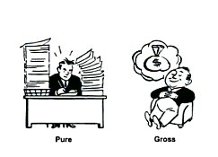
What to Include
Pure Work Time
Working 100% of your time with 100% focus on task – no interruptions, 100% productive
Gross Work Time
Includes time spent on other things than the tasks in the project list
Be consistent in their use
Notes:
Gross Work Time is full day, but Pure Work Time is somewhat less
Better to change calendar to reflect time working on project

Slide 7
Dependencies
A dependency is a relationship between the start and finish dates of two tasks that reflects a cause and effect between them
Not necessarily chronological sequence – predecessor & successor relationship

Slide 8
Dependencies
Successors can start earlier than predecessors
Better to think of it as driver and follower
Which task drives the other task

Slide 9
Intertask Dependencies
Finish-to-start (FS)
Start-to-start (SS)
Finish-to-finish (FF)
Start-to-finish (SF)
Notes:
The default in most project management software packages is “finish-to-start.” The other options are provided to improve scheduling flexibility based on intertask dependency.
FS – many examples, coding must complete before testing begins
SS – coding two modules can begin only after user signoff
FF – need to complete h/w testing and o/s testing at same time
SF – least common; one task means other must stop

Slide 10
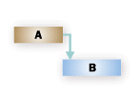
Intertask Dependencies
Finish-to-start (FS)—The dependent task (B) cannot begin until the task that it depends (A) on is complete.(default).
Example: B: “Pour concrete” cannot start until A: “Dig foundation” is finished.

Slide 11

Intertask Dependencies
Start-to-start (SS)— The dependent task (B) cannot begin until the task that it depends (A) on begins. They do not need to be done simultaneously.
Example: B: “Level concrete” cannot start until A: “Pour concrete” starts.

Slide 12

Intertask Dependencies
Finish-to-finish (FF)—The dependent task (B) cannot be completed until the task it depends on (A) is completed. They do not need to be done simultaneously.
Example: B: “Inspect electrical” cannot finish until A: “Add wiring” finishes.

Slide 13

Intertask Dependencies
Start-to-finish (SF)—The dependent task (B) cannot be completed until the task that it depends on (A) begins.
Example: B: “Assemble roof” cannot finish until A: “Truss delivery” begins.

Slide 14
Lead and Lag Time
Lag in a dependency is the time you need to wait between dependencies
Wait 10 days after completion of one task before start of next
Lead time is a partial dependency in which you need to wait for a certain time but not the whole time
Writing a report – editor can get it when it is partially complete
Entered as negative lag time
Notes:
Can be absolute or relative

Slide 15

Lead and Lag Time
Abundance of lag time can increase project duration
Abundance of lead time can increase risk
Notes:
Can be absolute or relative

Slide 16
Choosing Dependency
Which task drives the other?
Does the start or the finish of the predecessor drive the other task?
Does the predecessor drive the start or finish of the successor?
Should there be a lag or lead time in the dependency?

Slide 17
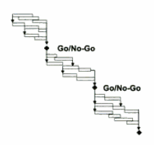
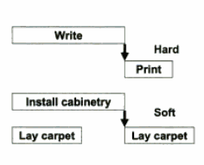
Categories of Dependencies
Decision Point Dependencies
All activities come together to a point that rely upon the decision
Hard and Soft Dependencies
Hard – must be dependent;
Soft – make it dependent but does not need to be
Notes:
Ask for examples

Slide 18
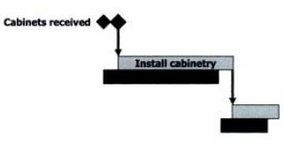

Categories of Dependencies
External Dependencies
Dependent on something from external source
Resource Dependencies
Forces tasks to be sequenced because of work overloads
Notes:
Ask for examples

Slide 19
Resource Levelling
Overallocation
A resource is overallocated when it is assigned too much work to complete within the resource's available time.
Notes:
When Microsoft Project schedules tasks, it calculates the schedule based on the requirements of the task, not the availability of resources assigned.

Slide 20
Resource Levelling
Overallocation resolved by resource leveling: adjusting either tasks or resources in the project.
Generally, resources are leveled in two ways:
By delaying a task until the assigned resource has time to work on it
By splitting a task, so that part of a task is done when planned, and the rest of it is done later when the assigned resource has time
Notes:
Can be done automatically by Microsoft Project.
If tasks occur in a sequence, use task dependencies to create that sequence.

Slide 21
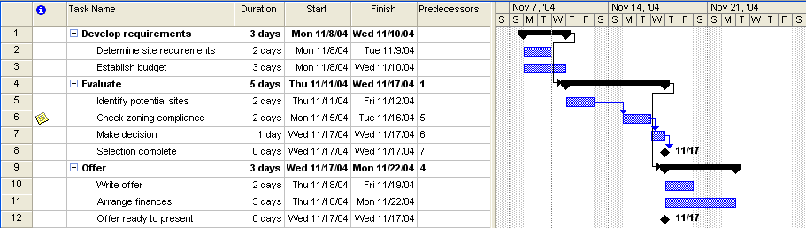
Before Resources Assigned

Slide 22
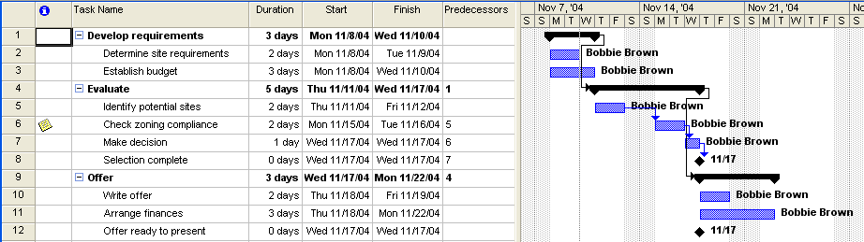
After Resources Assigned

Slide 23
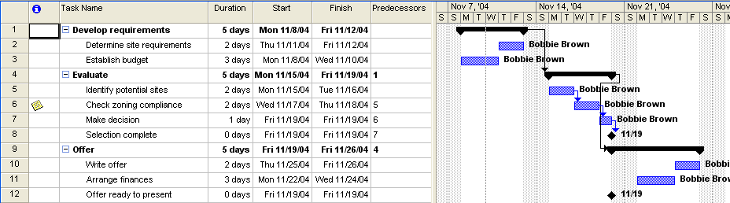
After Resources Levelled

